Slide 1
Basics of qualitative data analysis
IS 520 – Research Method

Slide 2
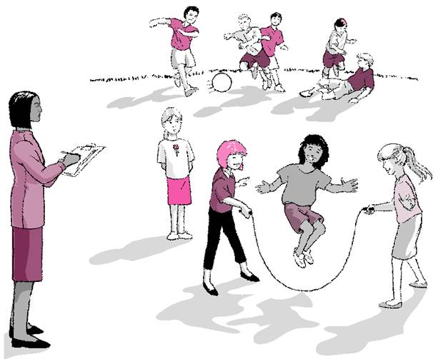
Qualitative Data Analysis
OBSERVATION

Slide 3
CONDUCTING OBSERVATION
Conducting Observation
The following are some standard rules for taking field notes (adapted from Neuman & Wiegand 2000):
Take notes as soon as possible, and do not talk to anyone before note taking
Count the number of times key words or phrases are used by members of the folk group
Carefully record the order or sequence of events, and how long each sequence lasts
Do not worry that anything is too insignificant; record even the smallest things

Slide 4
CONDUCTING OBSERVATION
Draw maps or diagrams of the location, including your movements and any reaction by others
Write quickly and don't worry about spelling; devise your own system of punctuation
Avoid evaluative judgments or summarizing; don't call something "dirty" for example, describe it
Include your own thoughts and feelings in a separate section; your later thoughts in another section
Always make backup copies of your notes and keep them in a separate location

Slide 5
CODING OBSERVATIONAL DATA
A coding scheme is a set of categories an observer uses to record a person’s or group’s behavior.
An observer still must choose what to observe, even with a fixed coding scheme.
These data are coded into categories that emerge as the analysis proceeds.

Slide 6
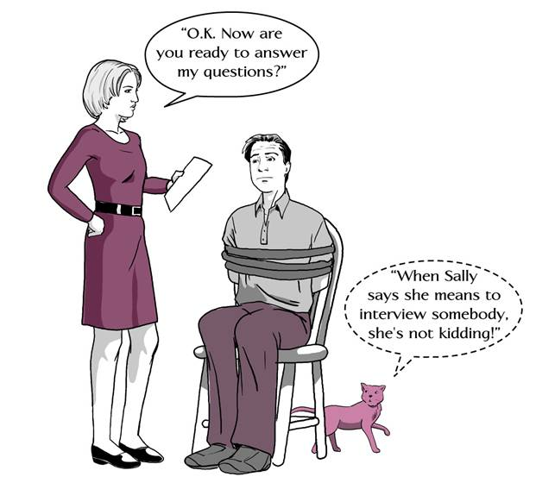
Qualitative Data Analysis
INTERVIEWING

Slide 7
Types of Interview Questions
Types of Interview Questions:
Background/demographic questions
Knowledge questions (when did program start?)
Basic descriptive questions (How questions)
Opinion/belief questions (What do you think...?)
Feeling questions (How do you feel about ...?)
Experience/examples questions
Comparison/contrast questions
Follow-up / clarification questions

Slide 8
Asking Good Questions
Asking good Questions:
Asking good questions requires practice (pilot interviews are crucial)
Questions you ask depend on the focus of your study
Questions should be clear and easy to understand
Questions should be specific
Questions should be open-ended
Alternative questions should be prepared
Different types of questions should be prepared
Questions to avoid:
Multiple Questions : How do you feel about the instructors and the classes?
Leading Questions: What emotional problems have you had since losing your job?
Yes – No Questions: Do you like the program? Has returning to school been difficult?

Slide 9
Interviewing Behavior
A set of expectations exists for all interviews:
Respect the culture of the group being studied
Respect the individual being interviewed
Be natural
Develop an appropriate rapport with the participant
Ask one question at a time
Ask the same question in different ways during the interview
Ask the interviewee to repeat an answer when in doubt
Vary who controls the flow of communication
Avoid leading questions
Don’t interrupt

Slide 10
Qualitative Data Analysis
What themes and patterns give shape to your data? What are the underlying ideas, issues, concepts?
Involves organizing data, examining, breaking down into manageable units, conceptualizing, comparing, synthesizing, searching for patterns
Like taking apart puzzles and reassembling them
Allows research findings to emerge from common, dominant or significant themes inherent in data

Slide 11
Qualitative Data Analysis
When to analyze?
Mode 1:
Data are collected before doing the analysis
Mode 2:
Concurrently with data collection. Analysis is completed more or less by the time the data are gathered.

Slide 12
Qualitative Data Analysis
Steps in Qualitative data analysis
Preparing the data
Close reading
Identifying meaningful segments & assigning conceptual labels (coding)
Generating themes
Organizing data by themes and labels
Developing & testing understandings
Looking for alternative explanations
Writing the report

Slide 13
Qualitative Data Analysis
How to Code?
Have a focus based on conceptual framework and research questions
Read through the data
Identify what seems to be important and ask questions (What is this? What does it represent? How does this compare to concept identified earlier?)
Give it a name (code\label\concept)
Levels of Details
Linguistic analyses: line by line or even word by word coding
Typically: larger units like sentences or paragraphs or a few paragraphs
Important: Be clear about what constitutes a unit of analysis
Not every piece must be coded.

Slide 14
Qualitative Data Analysis
Naming Coding
Source?
Data, literature, yourself
Can be changed, revised later
Methods of coding
Deductive coding (predefined): “Start list" of codes based on conceptual framework and research questions
Inductive coding (postdefined): reviewing data line by line, and generating labels, then more general labels describing these labels.
General scheme guided: A midway

Slide 15
Qualitative Data Analysis
Generating Themes
Group concepts that seem to pertain to the same phenomena
Theme: classroom climate
Codes: anxiety, warmth
Pull together a lot of concepts into more meaningful & more abstract units of analysis and gives shape to the final write-up
Reporting & Interpretation
Initial-descriptive codes go under these themes
Then we describe the data under these themes and codes
Attaching importance to what was found, offering explanations, drawing conclusions, making inferences, building linkages, attaching meanings, imposing order

Slide 16
References
Bogdan, C. R.& Biklen S.K.(1998).Qualitative Research for Education. An Introduction to Theory and Methods (3rd ed.). US: Allyn and Baon
Denzin, N. K. and Lincoln, Y. S. (1998). Collecting and interpreting qualitative materials. Thousand Oaks: Sage Pub. Inc.
Frankel, J. R. and Wallen, N. E. (2000). How to design and evaluate research in education, (4th ed.). Boston: McGraw-Hill Companies
Marshall,C.&Rossman G.B. (1999). Designing Qualitative Research. (3rd ed.). US: Sage Publication
Merriam, S. B. (1998). Qualitative research and case study applications in education, San Francisco:Jossey-Bass Publishers.
Newman, I. & Benz, C.R. (1998). Qualitative- Quantitative: Research Methodology. Southern Illinois University Press
Patton, M. Q. (1990). Qualitative evaluation methods (2nd ed.). Thousand Oaks: Sage Pub. Inc.

